Slide 1



CMR TECHNICAL CAMPUS
UGC AUTONOMUS
DEPARTMENT OF CSE
A MAJOR PROJECT ON
DEA-RNN A Hybrid Deep Learning Approach for Cyberbullying Detection in Twitter Social Media Platform
PRESENTED BY:
1. NAME : BATHULA PRAVALIKA
ROLLNO : 207R1A05K0
2. NAME : MOHAMMED MUBEEN
ROLLNO : 207R1A05M3
UNDER THE GUIDANCE OF:
Dr. J. NARASIMHARAO

Slide 2

ABSTRACT
EXISTING SYSTEM
DISADVANTAGES
PROPOSED SYSTEM
ADVANTAGES
HARDWARE AND SOFTWARE REQUIREMENTS
contents
NOVELTY OF PROJECT
ARCHITECTURE
MODULES
UML DIAGRAMS
SAMPLE CODE
RESULTS
CONCLUSION
FUTURE SCOPE
REFERENCE
GITHUB LINK

Slide 3

ABSTRACT
Cyberbullying poses a critical challenge to online safety, particularly on social media platforms like Twitter. In response to this, we propose DEA-RNN, a novel hybrid deep learning approach for the detection of cyberbullying.
This method integrates the strengths of Dolphin Echolocation Algorithm (DEA) and Recurrent Neural Networks (RNN) to enhance the model's understanding of complex language relationships within tweets.
DEA-RNN demonstrates superior performance compared to existing methods, showcasing higher accuracy and reduced false positives in cyberbullying detection.
This contributes a promising solution for real-time cyberbullying detection on the Twitter platform. By combining deep embedding and recurrent neural networks, DEA-RNN offers an effective tool for mitigating online safety risks and promoting community well-being.

Slide 4
EXISTING SYSTEM
The existing system encounters shortcomings related to machine learning classifiers, impeding its efficacy in cyberbullying detection.
This deficiency in classifier selection contributes to challenges like model complexity, reduced accuracy, and difficulty in handling nuances like sarcasm and multiple-meaning terms
Additionally, the system lacks the incorporation of advanced techniques like DEA-RNN, limiting its predictive capability and consequently diminishing accuracy in cyberbullying detection.
Addressing these deficiencies is imperative for enhancing the system's performance and adaptability to nuanced language in social media.

Slide 5
DISADVANTAGES OF EXISTING SYSTEM
DISADVANTAGES
Effective ML Classifiers: The system suffers from the absence of efficient machine learning classifiers, hindering its ability to detect cyberbullying effectively.
Limited Predictive Capability: The non-implementation of DEA-RNN techniques has led to reduced predictive power, resulting in lower accuracy in cyberbullying detection

Slide 6
PROPOSED SYSTEM
The proposed system, we introduce DEA-RNN, a powerful hybrid deep learningbased system designed to automatically detect cyberbullying in tweets.
DEA-RNN combines a type of neural network (RNN) with an enhanced algorithm inspired by dolphin echolocation (DEA).
This unique combination fine-tunes the neural network to be really good at understanding short and dynamic texts, like tweets, and picking up on the latest topics.
In tests, DEA-RNN consistently performs better than existing methods on Twitter, showing higher accuracy, precision, recall, F1 score, and specificity.
Our system stands out by using an optimized DEA model, integrating RNN with improved DEA for better tweet classification, introducing a new dataset for evaluation, and offering an efficient way to spot and categorize cyberbullying .

Slide 7
ADVANTAGES OF PROPOSED SYSTEM
Efficient Trending Topic Extraction: The system effectively identifies and extracts trending topics from tweets, aiding in focusing on significant discussions.
Effective Cyberbullying Identification: Through rigorous training and testing with classifiers like SVM, Multinomial Naive Bayes, and Random Forests, the system excels in identifying instances of cyberbullying.
Superior Accuracy: The proposed system consistently outperforms other methods, delivering a high level of accuracy in cyberbullying detection on platforms like Twitter

Slide 8
HARDWARE REQUIREMENTS
Processor : Pentium –IV.
RAM : 4 GB (min) .
Hard Disk : 20 GB .
Key Board : Standard Windows Keyboard.
Mouse : Two or Three Button Mouse . Monitor : SVGA.
HARDWARE REQUIREMENTS

Slide 9
SOFTWARE REQUIREMENTS
SOFTWARE REQUIREMENTS
Operating System : Windows 7 Ultimate.
Coding Language : Python.
Front-End : HTML, CSS, JavaScript.
Back-End : Django-ORM.
Database : MySQL (WAMP Server).

Slide 10


The DEA-RNN project innovates by combining advanced technologies, optimizing algorithms, introducing new evaluation datasets, and prioritizing efficiency in cyberbullying detection on the Twitter social media platform.
Hybrid Approach: Combining RNN and DEA for advanced cyberbullying detection on Twitter.
Optimized Model: Fine-tuned DEA algorithm for enhanced performance.
Improved Classification: Integration with RNN leads to better tweet categorization.
New Dataset: Testing on a fresh dataset for realistic evaluations.
Efficiency Focus: Quick and effective identification of cyberbullying instances on Twitter.
The novelty of the DEA-RNN project lies in its unique approach to automatically detecting cyberbullying on the Twitter social media platform using a hybrid deep learning method
NOVALITY OF PROJECT

Slide 11
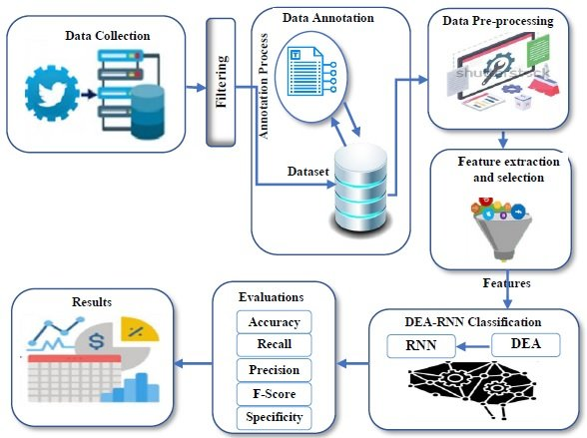
ARCHITETURE
FIG: ARCHITECTURE

Slide 12
MODULES
Service Provider:
Purpose: Login, Train & Test Data, View Accuracy, Predict Cyberbullying, Manage Users.
View and Authorize Users:
Purpose: Admin: View & Authorize Users.
Remote User:
Purpose: Register, Login, Predict Cyberbullying, View Profile.

Slide 13
UML DIAGRAMS
USE CASE DIAGRAM

Slide 14
FLOW CHART

Slide 15
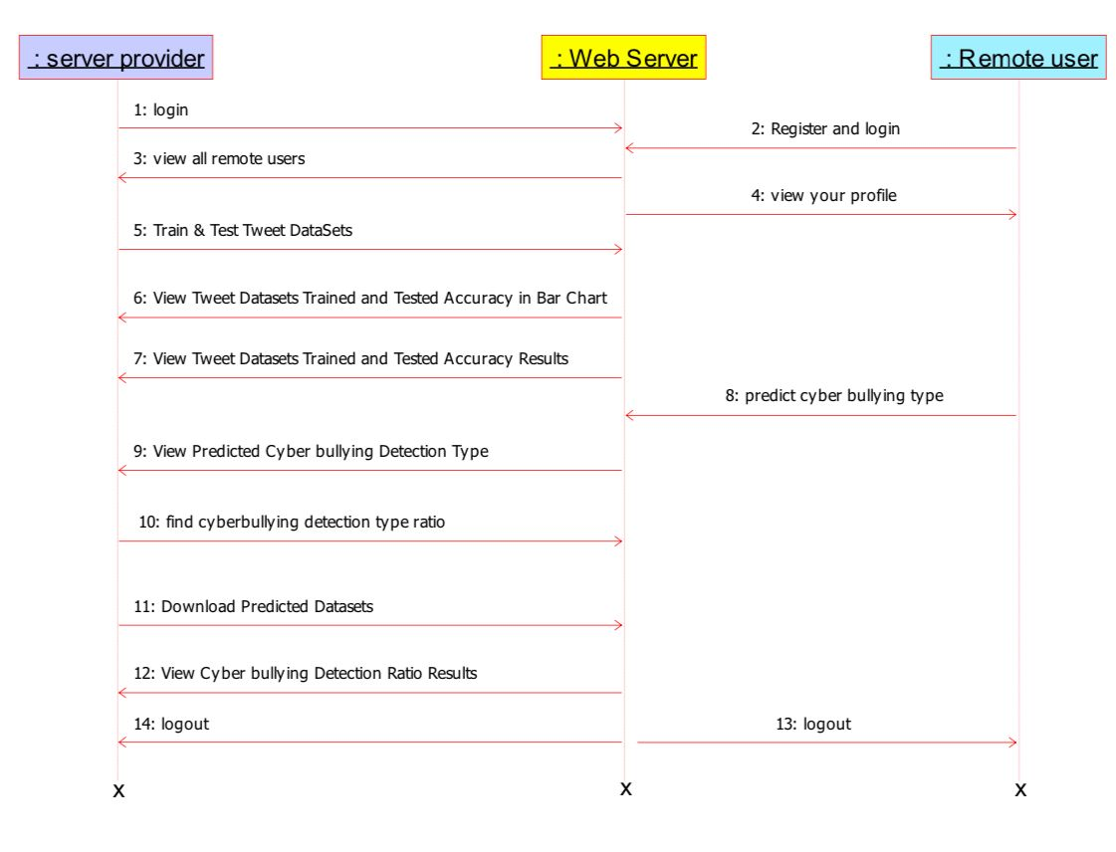
Sequence Diagram

Slide 16
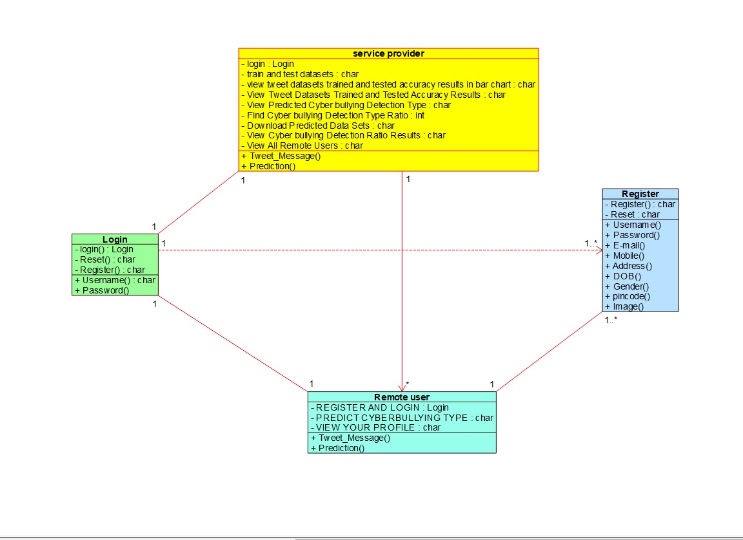
CLASS DIAGRAM

Slide 17
Data Flow Diagram

Slide 18
Sample Code:
def Find_Predicted_Cyberbullying_Detection_Ratio(request):
detection_ratio.objects.all().delete()
ratio = ""
kword = 'not_cyberbullying'
print(kword)
obj = Cyberbullying_Detection_Type.objects.all().filter(Q(Prediction=kword))
obj1 = Cyberbullying_Detection_Type.objects.all()
count = obj.count();
count1 = obj1.count();
ratio = (count / count1) * 100
if ratio != 0:
detection_ratio.objects.create(names=kword, ratio=ratio)
ratio1 = ""
kword1 = 'gender'
print(kword1)
obj1 = Cyberbullying_Detection_Type.objects.all().filter(Q(Prediction=kword1))
obj11 = Cyberbullying_Detection_Type.objects.all()
count1 = obj1.count();
count11 = obj11.count();
ratio1 = (count1 / count11) * 100
if ratio1 != 0:
detection_ratio.objects.create(names=kword1, ratio=ratio1)
ratio12 = ""
kword12 = 'religion'
print(kword12)
obj12 = Cyberbullying_Detection_Type.objects.all().filter(Q(Prediction=kword12))
obj112 = Cyberbullying_Detection_Type.objects.all()
count12 = obj12.count();
count112 = obj112.count();
ratio12 = (count12 / count112) * 100
if ratio12 != 0:
detection_ratio.objects.create(names=kword12, ratio=ratio12)
from django.db.models import Count, Avg
from django.shortcuts import render, redirect
from django.db.models import Count
from django.db.models import Q
import datetime
import xlwt
from django.http import HttpResponse
import re
import string
import pandas as pd
from wordcloud import WordCloud, STOPWORDS
from sklearn.feature_extraction.text import CountVectorizer
from sklearn.metrics import accuracy_score, confusion_matrix, classification_report
from sklearn.metrics import accuracy_score
from sklearn.metrics import f1_score
from sklearn.tree import DecisionTreeClassifier
from sklearn.ensemble import VotingClassifier
# Create your views here.
from Remote_User.models import ClientRegister_Model,Cyberbullying_Detection_Type,detection_ratio,detection_accuracy
def serviceproviderlogin(request):
if request.method == "POST":
admin = request.POST.get('username')
password = request.POST.get('password')
if admin == "Admin" and password =="Admin":
return redirect('View_Remote_Users')
return render(request,'SProvider/serviceproviderlogin.html')

Slide 19
ratio123 = ""
kword123 = 'other_cyberbullying'
print(kword123)
obj123 = Cyberbullying_Detection_Type.objects.all().filter(Q(Prediction=kword123))
obj1123 = Cyberbullying_Detection_Type.objects.all()
count123 = obj123.count();
count1123 = obj1123.count();
ratio123 = (count123 / count1123) * 100
if ratio123 != 0:
detection_ratio.objects.create(names=kword123, ratio=ratio123)
ratio1234 = ""
kword1234 = 'age'
print(kword1234)
obj1234 = Cyberbullying_Detection_Type.objects.all().filter(Q(Prediction=kword1234))
obj11234 = Cyberbullying_Detection_Type.objects.all()
count1234 = obj1234.count();
count11234 = obj11234.count();
ratio1234 = (count1234 / count11234) * 100
if ratio1234 != 0:
detection_ratio.objects.create(names=kword1234, ratio=ratio1234)
ratio123491 = ""
kword123491 = 'ethnicity'
print(kword123491)
obj123491 = Cyberbullying_Detection_Type.objects.all().filter(Q(Prediction=kword123491))
obj1123491 = Cyberbullying_Detection_Type.objects.all()
count123491 = obj123491.count();
count1123491 = obj1123491.count();
ratio123491 = (count123491 / count1123491) * 100
if ratio123491 != 0:
detection_ratio.objects.create(names=kword123491, ratio=ratio123491)
ratio123 = (count123 / count1123) * 100
if ratio123 != 0:
detection_ratio.objects.create(names=kword123, ratio=ratio123)
ratio1234 = ""
kword1234 = 'age'
print(kword1234)
obj1234 = Cyberbullying_Detection_Type.objects.all().filter(Q(Prediction=kword1234))
obj11234 = Cyberbullying_Detection_Type.objects.all()
count1234 = obj1234.count();
count11234 = obj11234.count();
ratio1234 = (count1234 / count11234) * 100
if ratio1234 != 0:
detection_ratio.objects.create(names=kword1234, ratio=ratio1234)
ratio123491 = ""
kword123491 = 'ethnicity'
print(kword123491)
obj123491 = Cyberbullying_Detection_Type.objects.all().filter(Q(Prediction=kword123491))
obj1123491 = Cyberbullying_Detection_Type.objects.all()
count123491 = obj123491.count();
count1123491 = obj1123491.count();
ratio123491 = (count123491 / count1123491) * 100
if ratio123491 != 0:
detection_ratio.objects.create(names=kword123491, ratio=ratio123491)
obj = detection_ratio.objects.all()
return render(request, 'SProvider/Find_Predicted_Cyberbullying_Detection_Ratio.html', {'objs': obj})
def View_Remote_Users(request):
obj=ClientRegister_Model.objects.all()
return render(request,'SProvider/View_Remote_Users.html',{'objects':obj})
def ViewTrendings(request):
topic = Cyberbullying_Detection_Type.objects.values('topics').annotate(dcount=Count('topics')).order_by('-dcount')

Slide 20
return render(request,'SProvider/ViewTrendings.html',{'objects':topic})
font_style.font.bold = True
# writer = csv.writer(response)
obj = Cyberbullying_Detection_Type.objects.all()
data = obj # dummy method to fetch data.
for my_row in data:
row_num = row_num + 1
print("SGD Classifier")
from sklearn.linear_model import SGDClassifier
sgd_clf = SGDClassifier(loss='hinge', penalty='l2', random_state=0)
sgd_clf.fit(X_train, y_train)
sgdpredict = sgd_clf.predict(X_test)
print("ACCURACY")
print(accuracy_score(y_test, sgdpredict) * 100)
print("CLASSIFICATION REPORT")
print(classification_report(y_test, sgdpredict))
print("CONFUSION MATRIX")
print(confusion_matrix(y_test, sgdpredict))
models.append(('SGDClassifier', sgd_clf))
detection_accuracy.objects.create(names="SGD Classifier", ratio=accuracy_score(y_test, sgdpredict) * 100)
csv_format = 'Results.csv'
data.to_csv(csv_format, index=False)
data.to_markdown
obj = detection_accuracy.objects.all()
return render(request,'SProvider/Train_Test_DataSets.html', {'objs': obj})
def charts(request,chart_type):
chart1 = detection_ratio.objects.values('names').annotate(dcount=Avg('ratio'))
return render(request,"SProvider/charts.html", {'form':chart1, 'chart_type':chart_type})
def charts1(request,chart_type):
chart1 = detection_accuracy.objects.values('names').annotate(dcount=Avg('ratio'))
return render(request,"SProvider/charts1.html", {'form':chart1, 'chart_type':chart_type})
def View_Predicted_Cyberbullying_Detection_Type(request):
obj =Cyberbullying_Detection_Type.objects.all()
return render(request, 'SProvider/View_Predicted_Cyberbullying_Detection_Type.html', {'list_objects': obj})
def likeschart(request,like_chart):
charts =detection_accuracy.objects.values('names').annotate(dcount=Avg('ratio'))
return render(request,"SProvider/likeschart.html", {'form':charts, 'like_chart':like_chart})
def Download_Predicted_DataSets(request):
response = HttpResponse(content_type='application/ms-excel')
# decide file name
response['Content-Disposition'] = 'attachment; filename="Predicted_Data.xls"'
# creating workbook
wb = xlwt.Workbook(encoding='utf-8')
# adding sheet
ws = wb.add_sheet("sheet1")
# Sheet header, first row
row_num = 0
font_style = xlwt.XFStyle()
# headers are bold

Slide 21
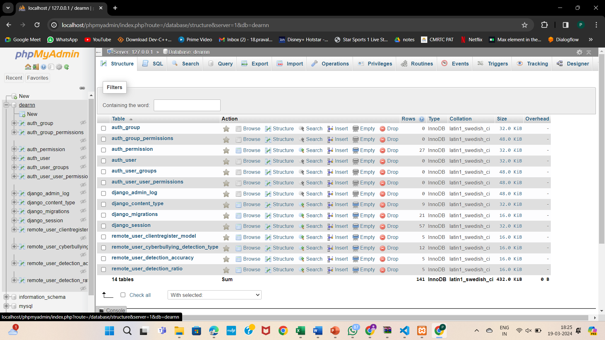
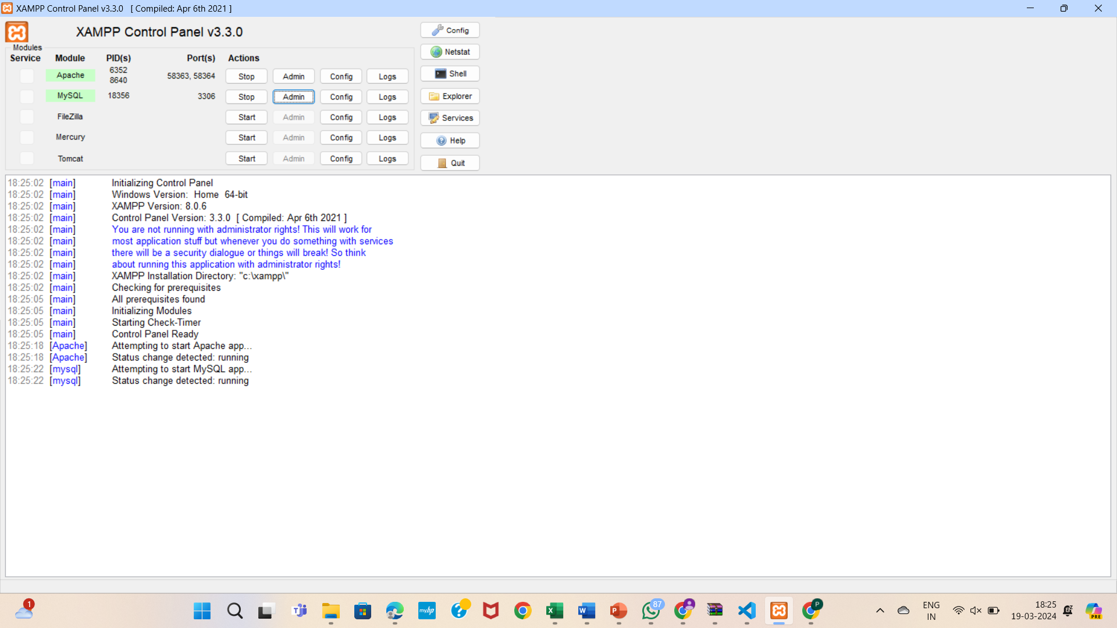
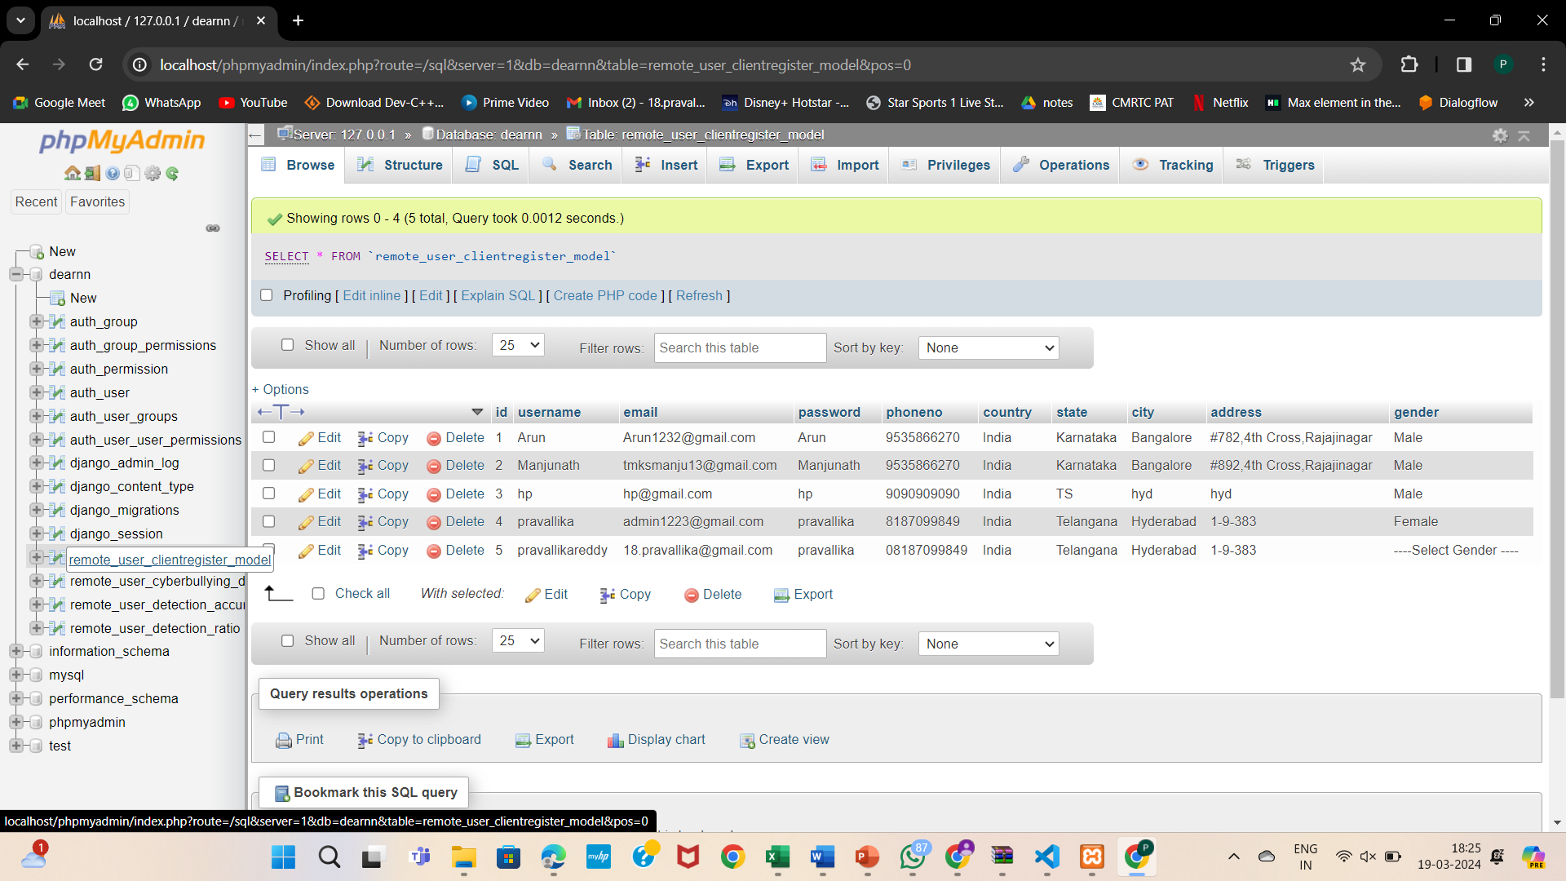
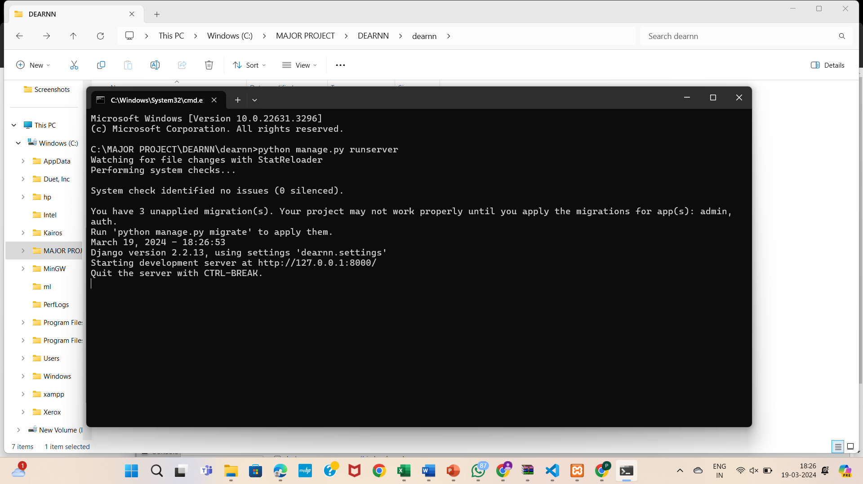
RESULTS
1.Open xamp and start apache and mysql-admin
2. Open dearnn and it contain databases
3.Databases
4.Open Command prompt

Slide 22



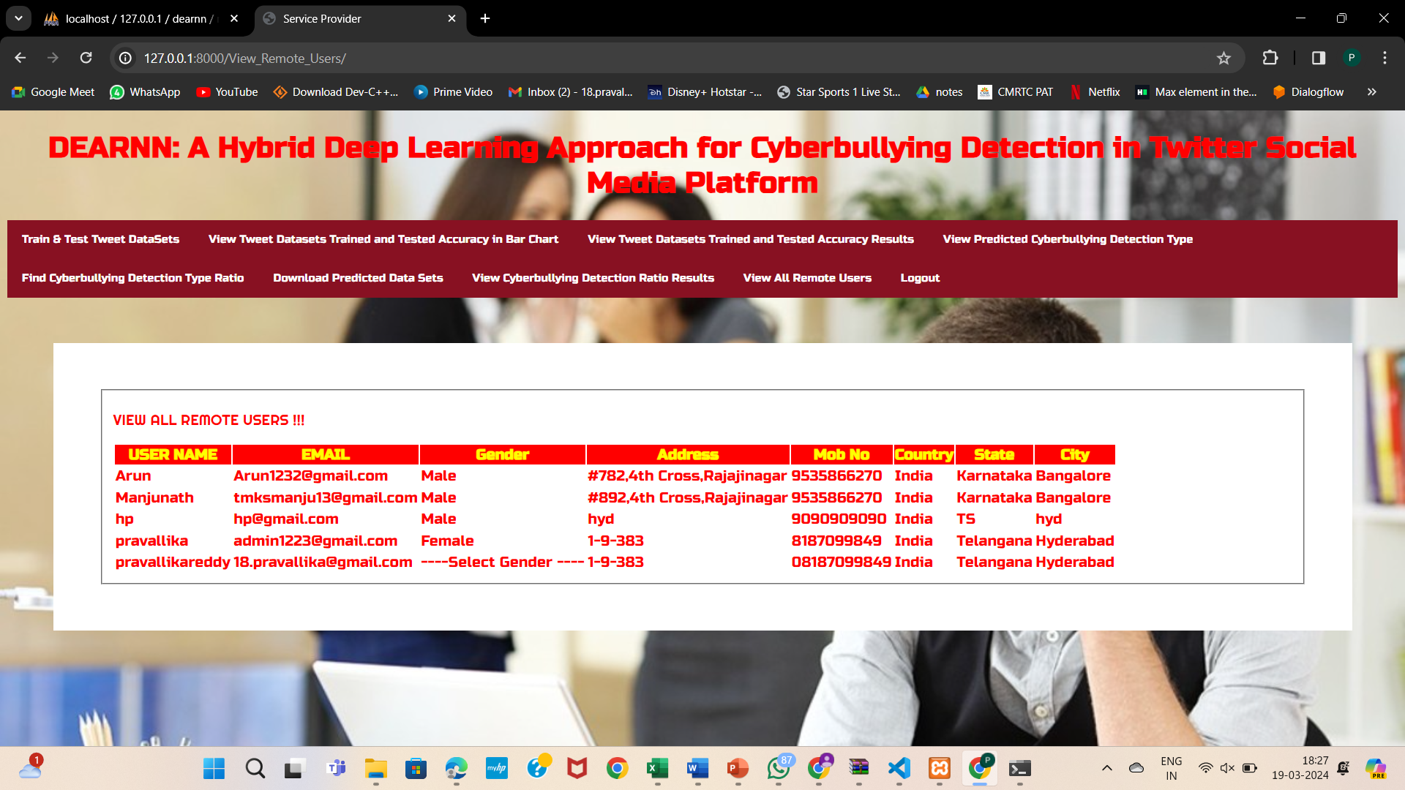
5.Login page
6.Login service provider
7.Register remote user
8.View all remote users in service provider

Slide 23
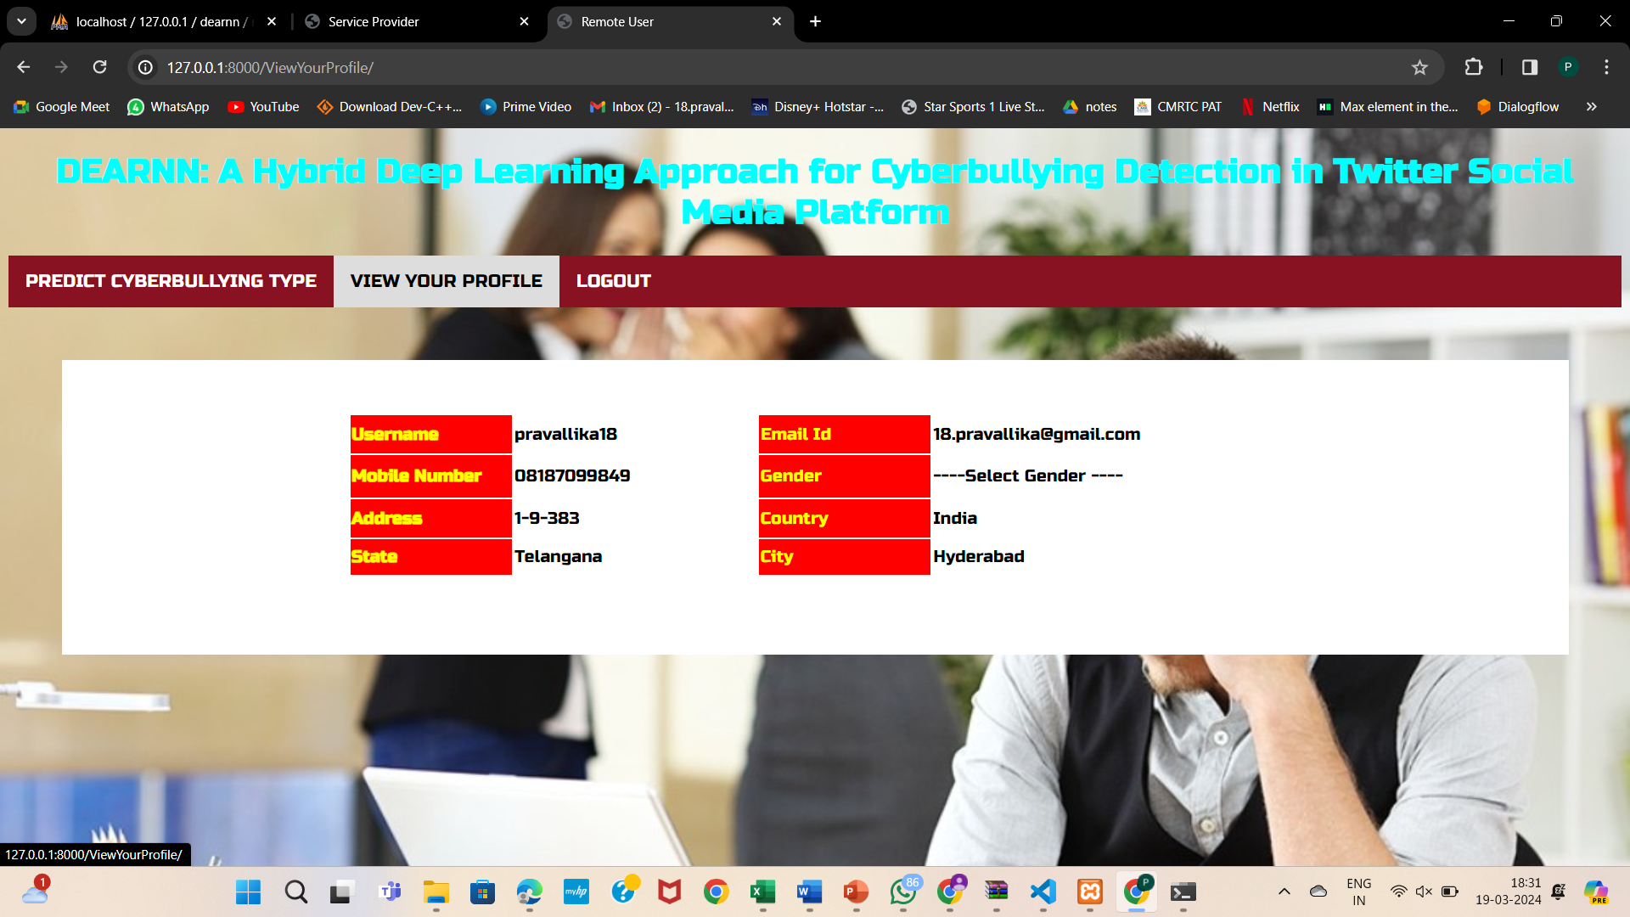
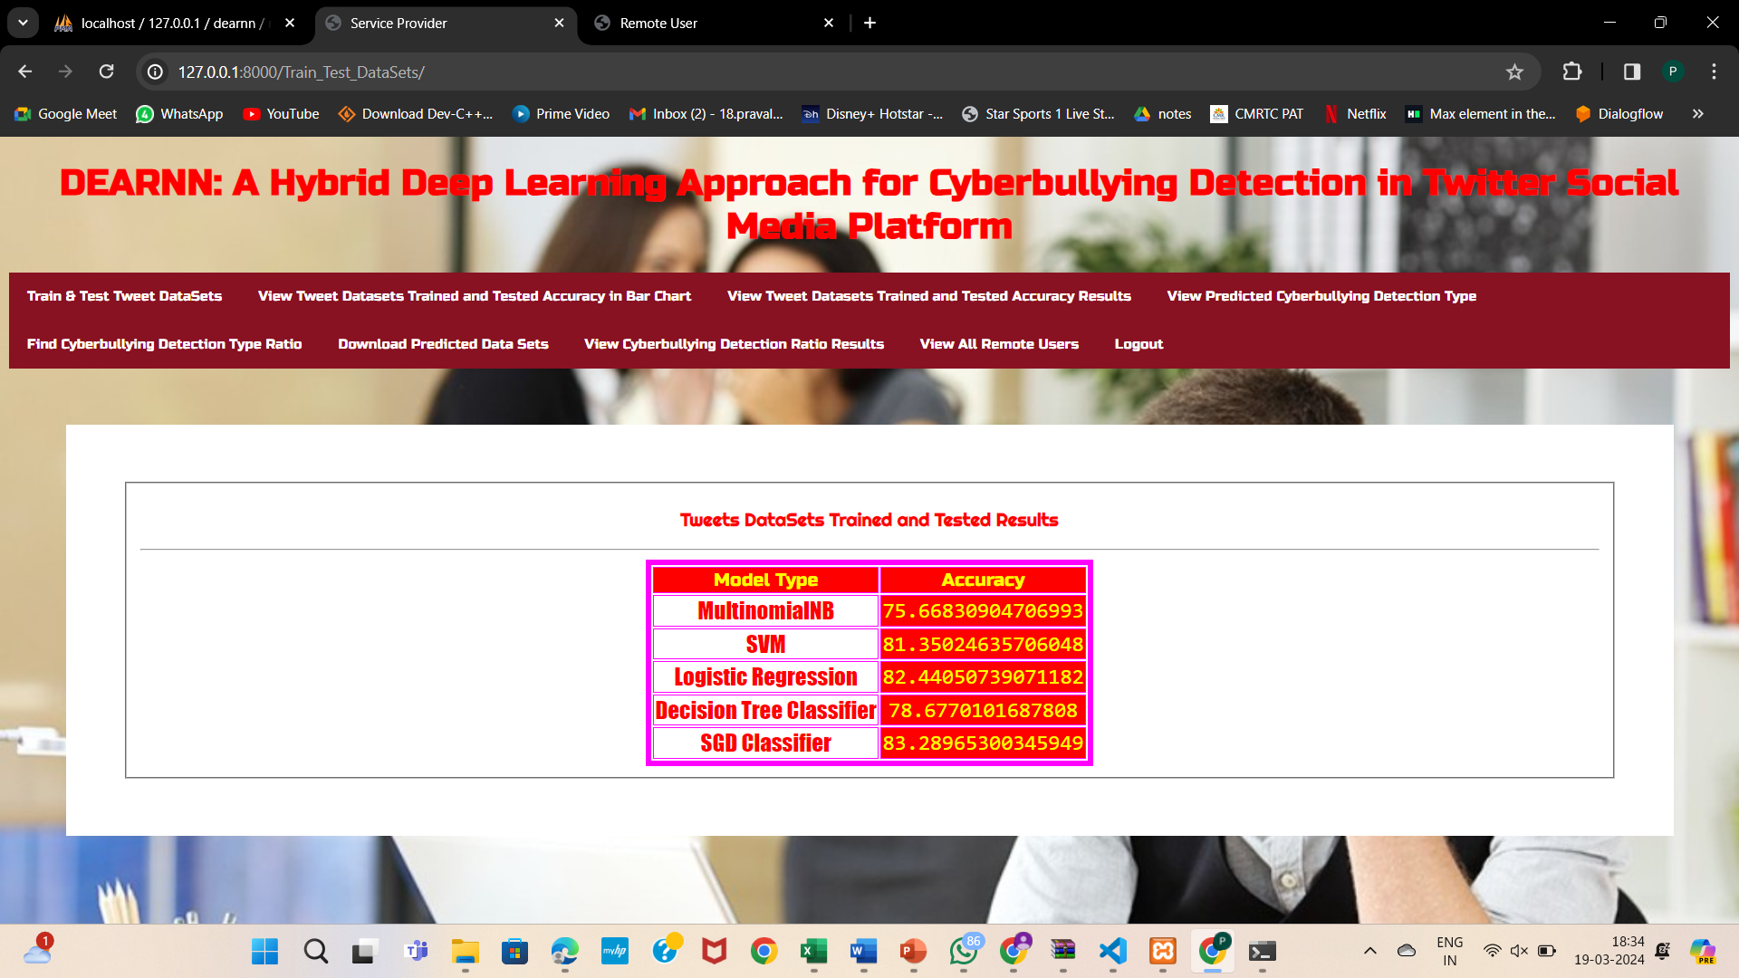
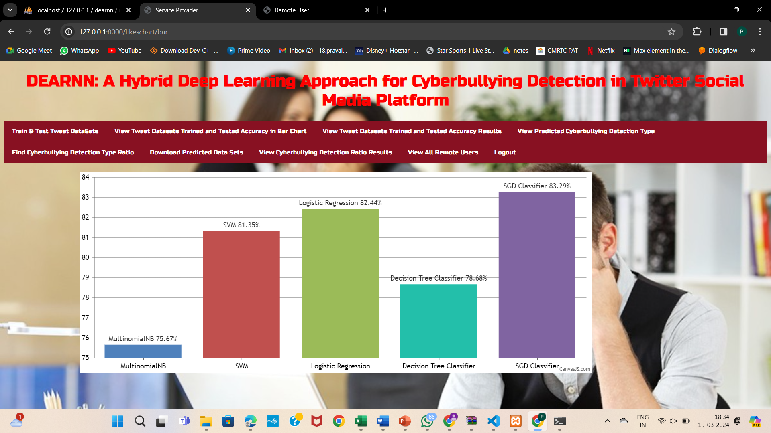
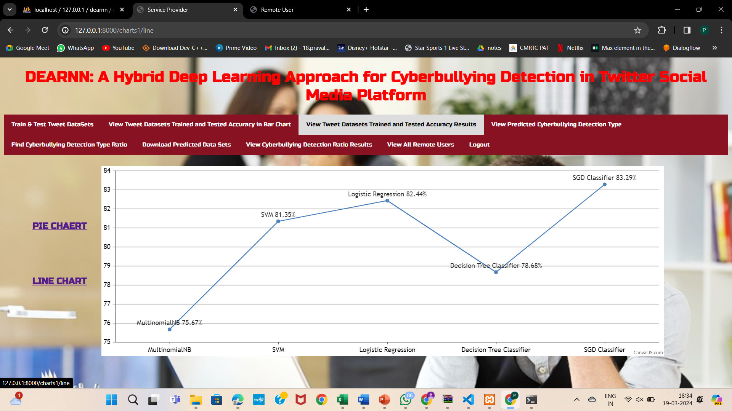
9.View your profile of remote user
10.Train and test tweet data sets
11.View tweet Datasets Trained andTested Accuracy in Bar Chart
12.View Tweet Datasets Trained and Tested Accuracy Results

Slide 24
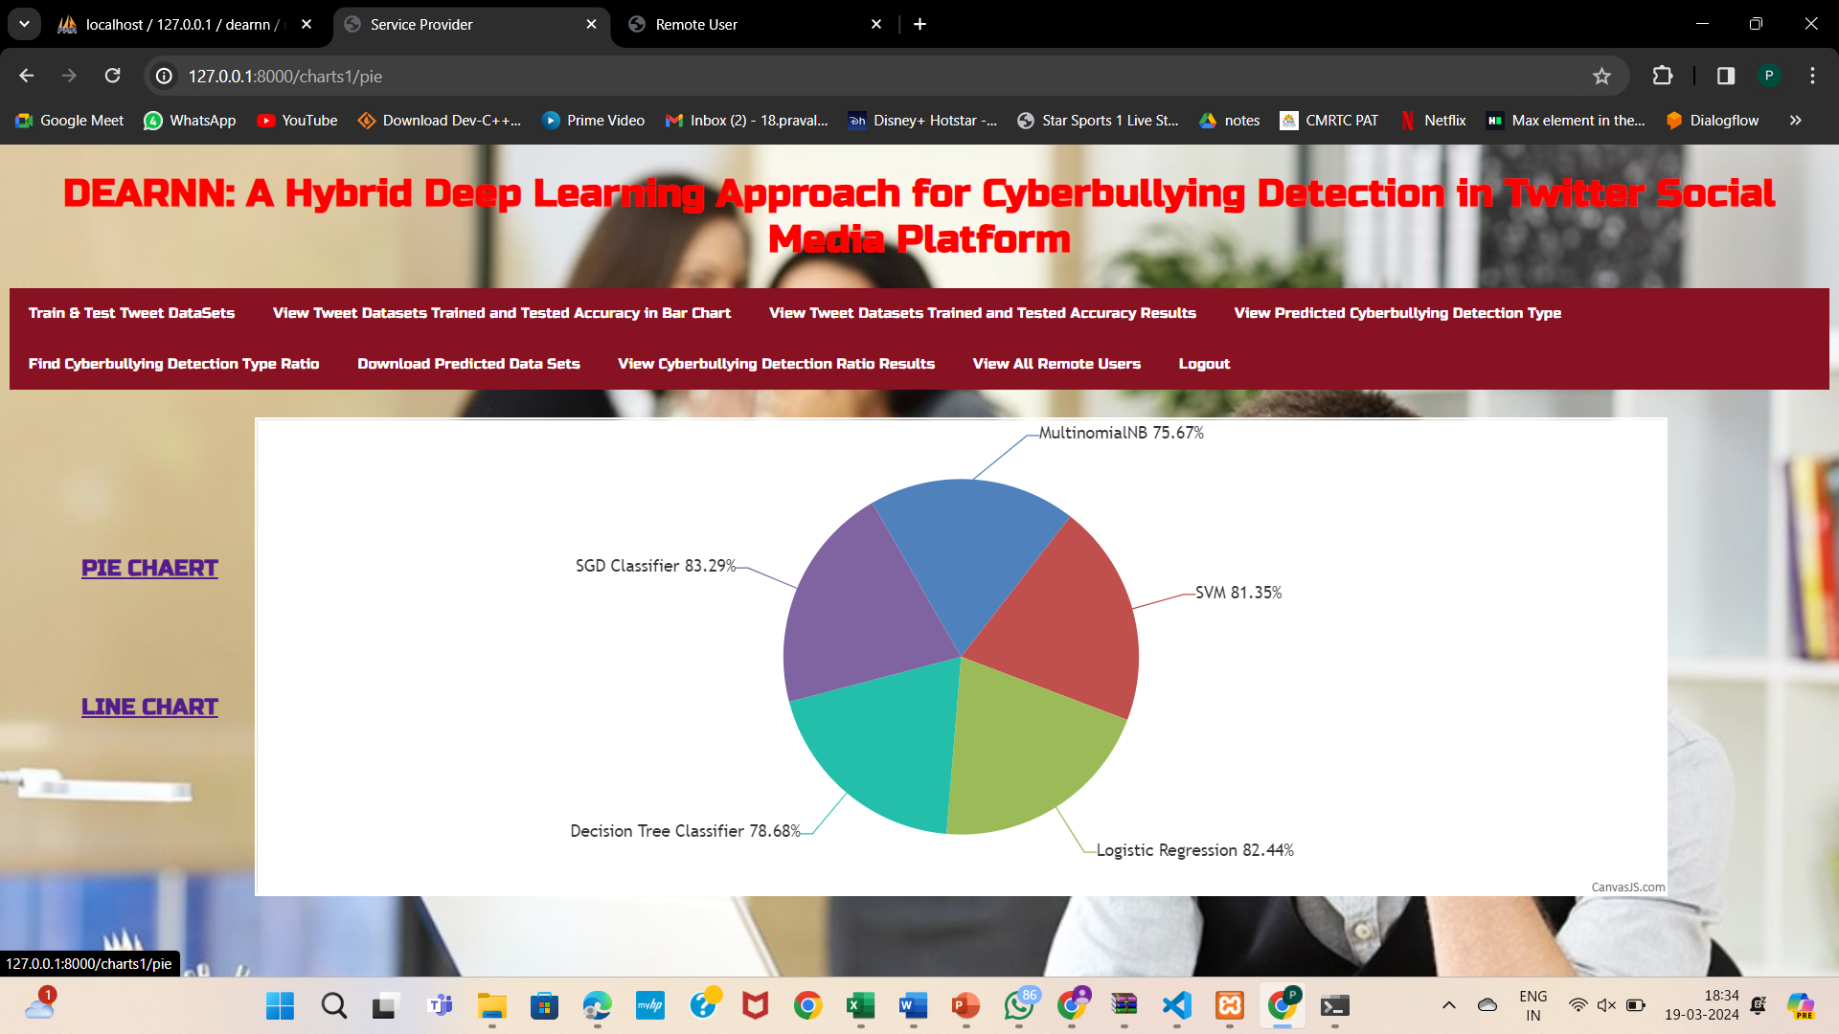
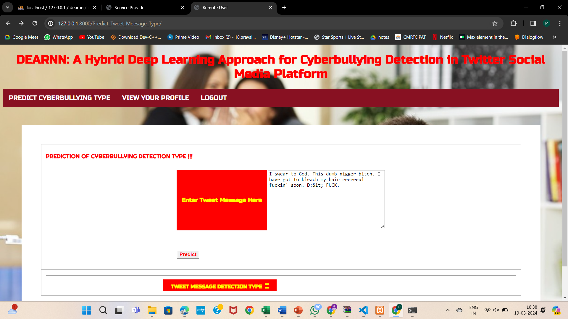
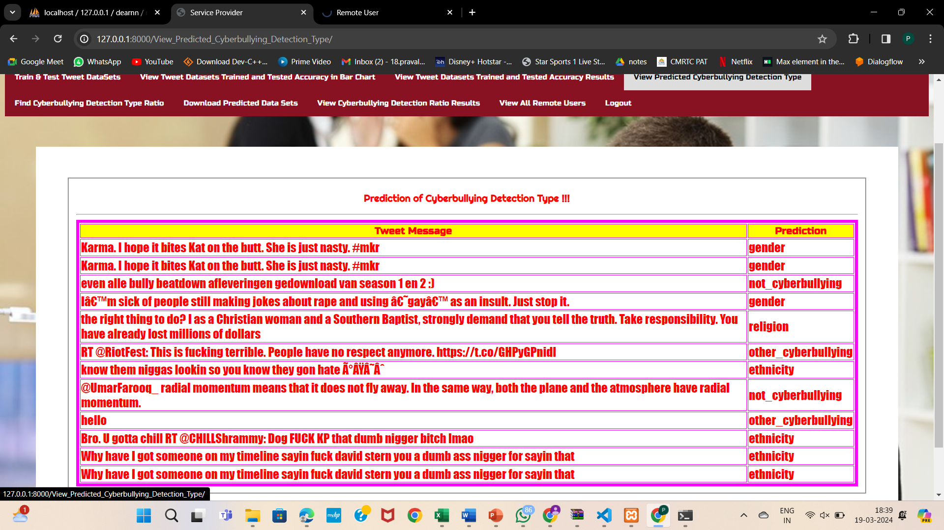
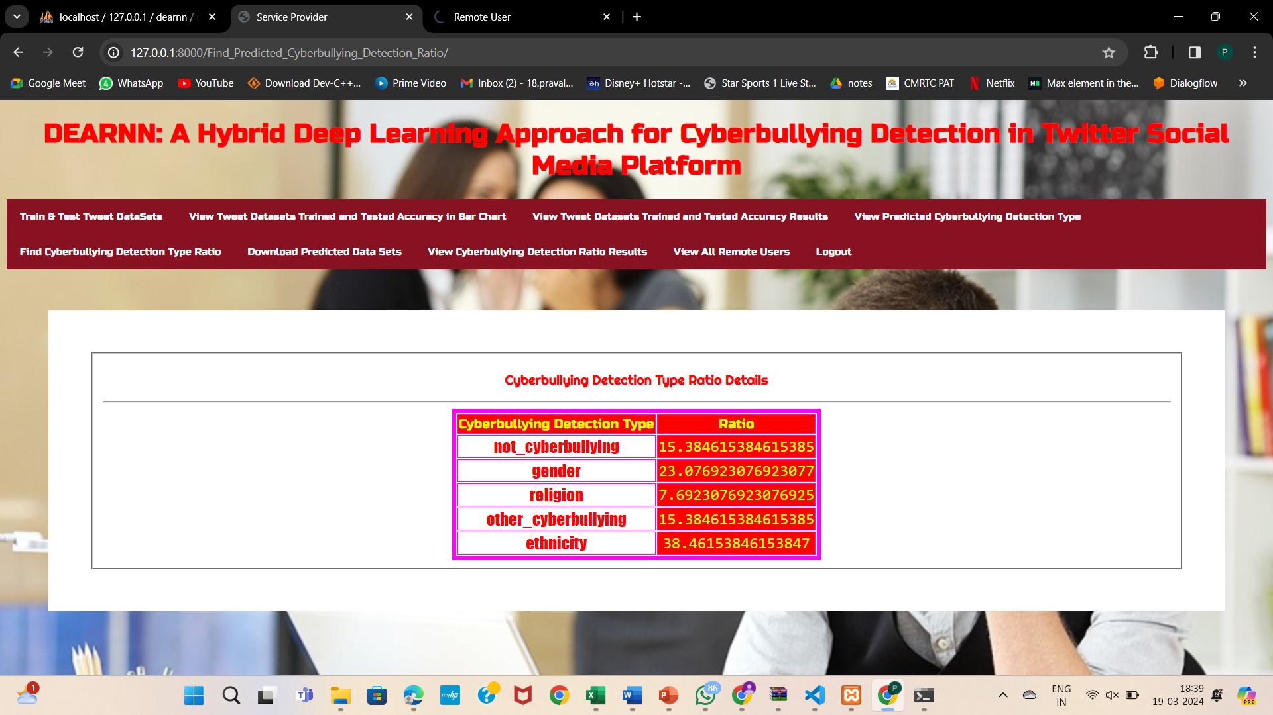
13.Pie chart
14.Predict cyberbullying type in remote user
15.View predicted cyberbullying detection type
16.Find cyberbullying Detection Type Ratio

Slide 25
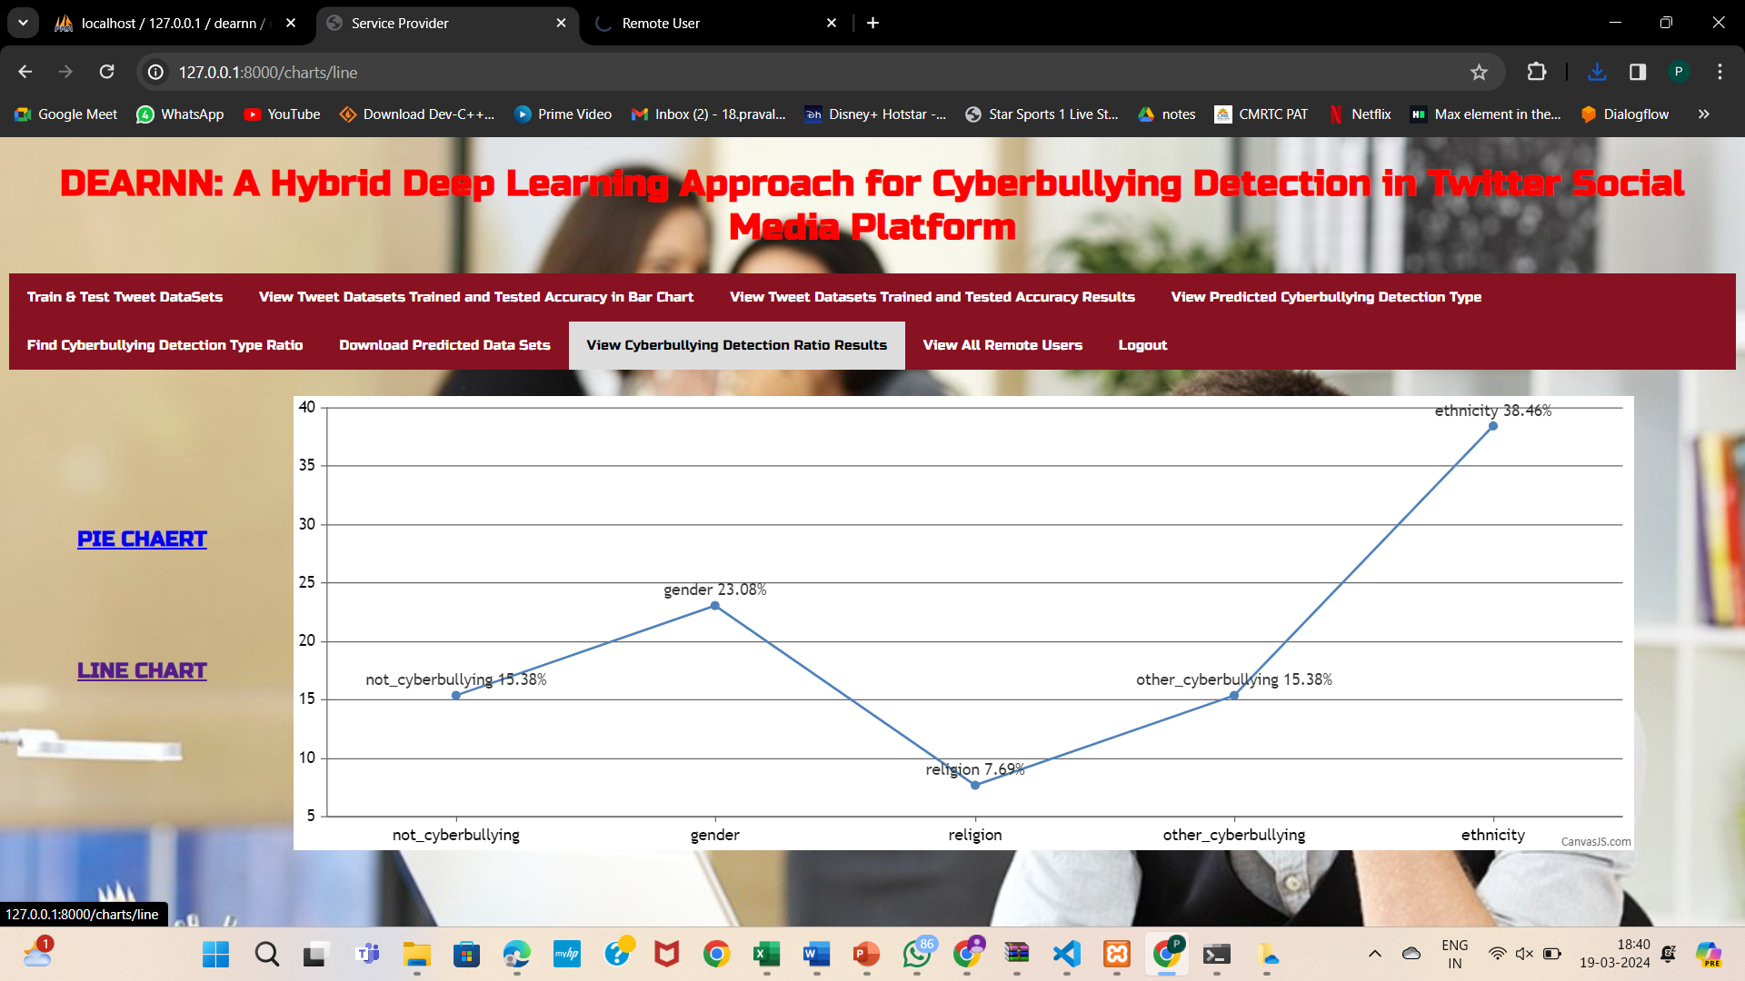
17.View Cyberbullying Detection Ratio Results

Slide 26

CONCLUSION
The DEA-RNN method, which combines deep autoencoders and recurrent neural networks, is proving effective in spotting cyberbullying on Twitter. It does well in accurately identifying instances of cyberbullying by understanding both the language used and the context. Although more improvements and real-world testing are required, DEA-RNN is a valuable step towards tackling cyberbullying and making online spaces safer. Its potential to encourage responsible online behavior is significant.

Slide 27
FUTURE SCOPE
Get Better at Finding Bullying: Make the model better at spotting cyberbullying by tweaking how it works.
Stronger Against Tricks: Make the model tougher so it doesn't get fooled easily by tricky messages.
Use More Than Just Text: Make the model understand pictures and other stuff, not just words.
Be Quick: Make the model work fast so it can catch bullying as it happens on Twitter.
Work Everywhere: Make sure the model can find bullying on different social media sites and in different languages.
Respect People's Privacy: Make sure the model doesn't invade people's privacy and follows the rules.
Listen to People: Let people help improve the model by telling it when it makes mistakes.

Slide 28
REFERENCE
[1] F. Mishna, M. Khoury-Kassabri, T. Gadalla, and J. Daciuk, ``Risk factors for involvement in cyber bullying: Victims, bullies and bully_victims,''
Children Youth Services Rev., vol. 34, no. 1, pp. 63_70, Jan. 2012, doi: 10.1016/j.childyouth.2011.08.032.
[2] K. Miller, ``Cyberbullying and its consequences: How cyberbullying is contorting the minds of victims and bullies alike, and the law's limited
available redress,'' Southern California Interdiscipl. Law J., vol. 26, no. 2, p. 379, 2016.
[3] A. M. Vivolo-Kantor, B. N. Martell, K. M. Holland, and R. Westby, ``A systematic review and content analysis of bullying and cyber-bullying measurement strategies,'' Aggression Violent Behav., vol. 19, no. 4, pp. 423_434, Jul. 2014, doi: 10.1016/j.avb.2014.06.008.
[4] H. Sampasa-Kanyinga, P. Roumeliotis, and H. Xu, ``Associations between cyberbullying and school bullying victimization and suicidal ideation,
plans and attempts among Canadian schoolchildren,'' PLoS ONE, vol. 9, no. 7, Jul. 2014, Art. no. e102145, doi: 10.1371/journal.pone.0102145.
[5] M. Dadvar, D. Trieschnigg, R. Ordelman, and F. de Jong, ``Improving cyberbullying detection with user context,'' in Proc. Eur. Conf. Inf. Retr.,
in Lecture Notes in Computer Science: Including Subseries Lecture Notes in Arti_cial Intelligence and Lecture Notes in Bioinformatics, vol. 7814, 2013, pp. 693_696.

Slide 29
GITHUB LINK
https://github.com/207R1A05K0/dea-rnn-A-Hybrid-Deep-Learning-Approach-for-Cyberbullying-Detection-in-Twitter-Social-Media-Platform

Slide 30


